Slide 1
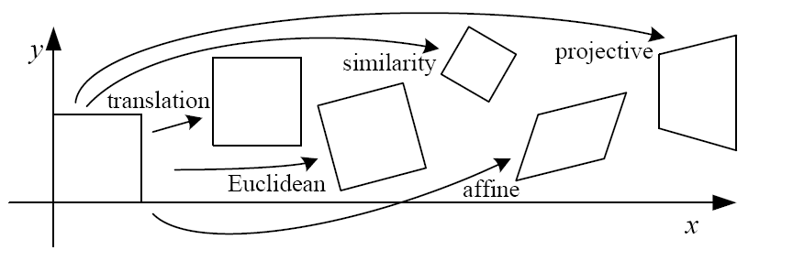
Image transformations and image warping
CS5670: Computer Vision
Prof. Zhu Zhiyu

Slide 2
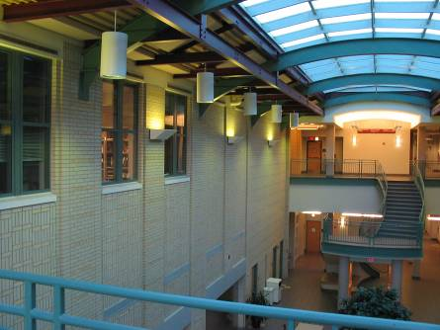
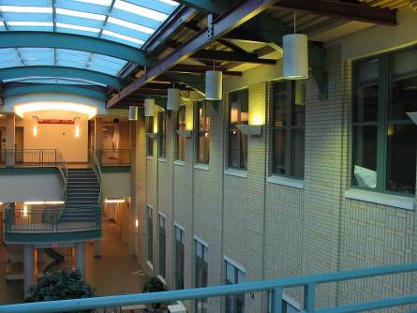
Image alignment

Slide 3
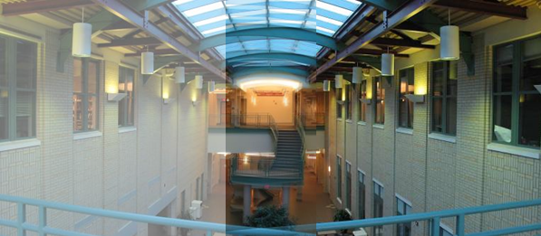
Image alignment
Why don’t these image line up exactly?

Slide 4


What is the geometric relationship between these two images?
?
Answer: Similarity transformation (translation, rotation, uniform scale)

Slide 5
What is the geometric relationship between these two images?
?

Slide 6
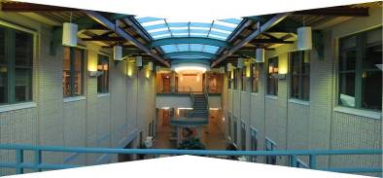
What is the geometric relationship between these two images?
Very important for creating mosaics!
First, we need to know what this transformation is.
Second, we need to figure out how to compute it using feature matches.

Slide 7
Image Warping
image filtering: change range of image
g(x) = h(f(x))
image warping: change domain of image
g(x) = f(h(x))
f
g
h
x
x
f
g
h
x
x

Slide 8
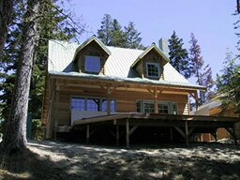
Image Warping
image filtering: change range of image
g(x) = h(f(x))
image warping: change domain of image
g(x) = f(h(x))
f
g
h
f
g
h

Slide 9
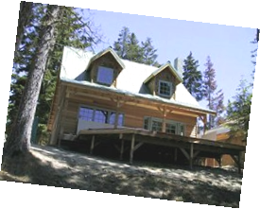
Parametric (global) warping
Examples of parametric warps:
translation
rotation
aspect

Slide 10
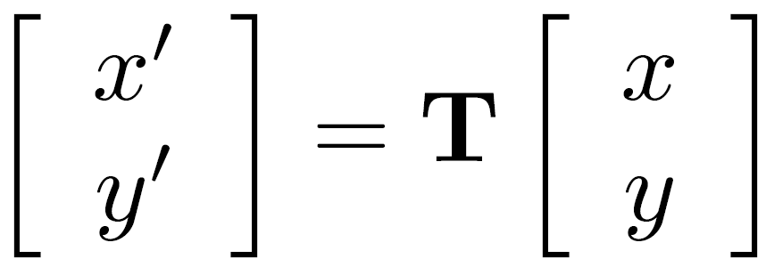

Parametric (global) warping
T
p = (x,y)
p’ = (x’,y’)
Transformation T is a coordinate-changing machine:
p’ = T(p)
What does it mean that T is global?
  Is the same for any point p
  can be described by just a few numbers (parameters)
Let’s consider linear xforms (can be represented by a 2x2 matrix):

Slide 11
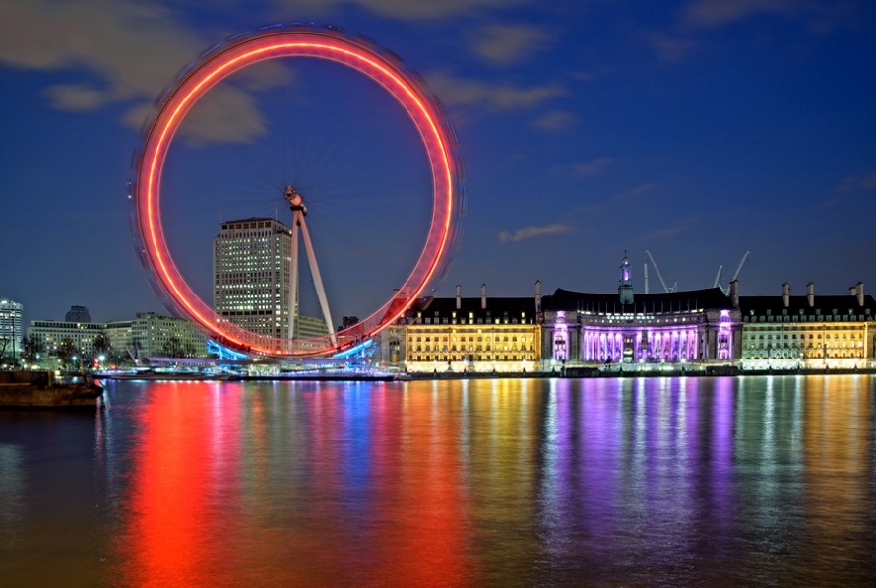

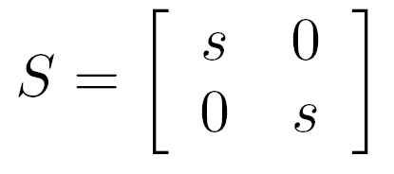

Common linear transformations
Uniform scaling by s:
(0,0)
(0,0)
What is the inverse?

Slide 12
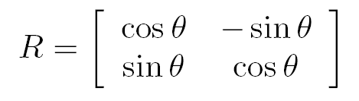


Common linear transformations
Rotation by angle θ (about the origin)
(0,0)
(0,0)
θ
What is the inverse?
For rotations:

Slide 13
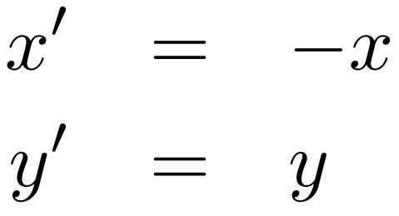
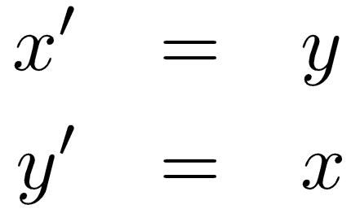
2x2 Matrices
What types of transformations can be
represented with a 2x2 matrix?
2D mirror across Y axis?
2D mirror across line y = x?

Slide 14
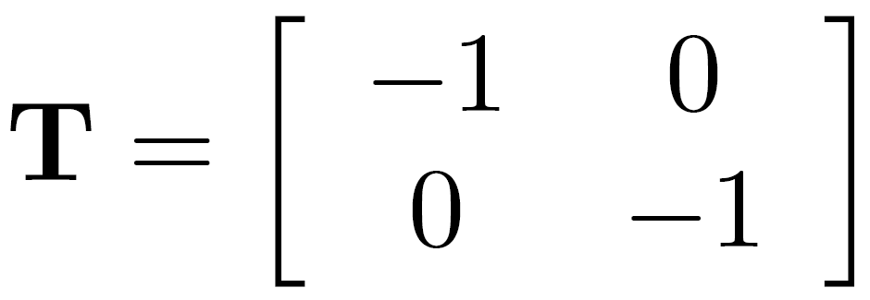
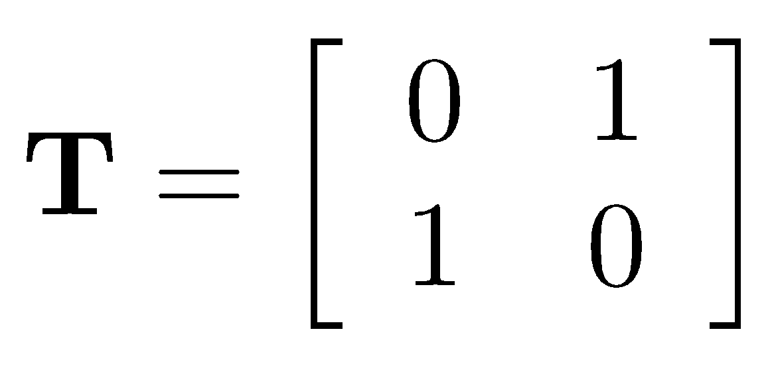
2x2 Matrices
What types of transformations can be
represented with a 2x2 matrix?
2D mirror across Y axis?
2D mirror across line y = x?

Slide 15
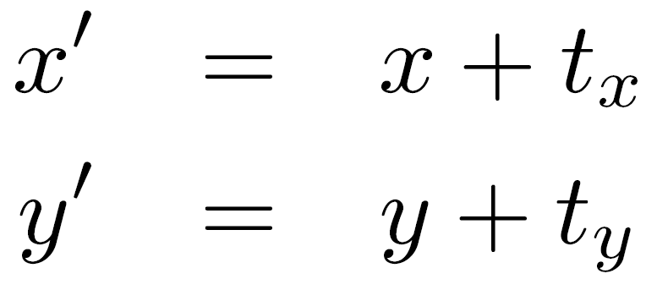
2x2 Matrices
What types of transformations can be
represented with a 2x2 matrix?
2D Translation?

Slide 16

Can a 2D translation by (tx,ty) be represented with a 2x2 matrix transformation?
ⓘ Start presenting to display the poll results on this slide.

Slide 17
2x2 Matrices
What types of transformations can be
represented with a 2x2 matrix?
2D Translation?
NO!
Translation is not a linear operation on 2D coordinates

Slide 18
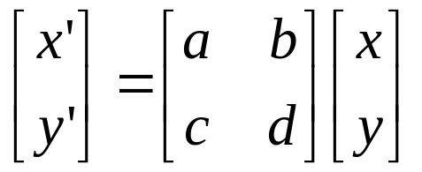
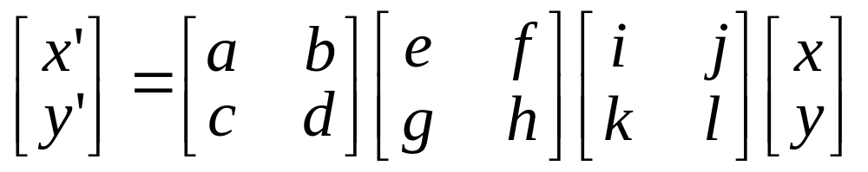
All 2D Linear Transformations
Linear transformations are combinations of …
  Scale,
  Rotation,
  Shear, and
  Mirror
Properties of linear transformations:
  Origin maps to origin
  Lines map to lines
  Parallel lines remain parallel
  Ratios are preserved
  Closed under composition

Slide 19
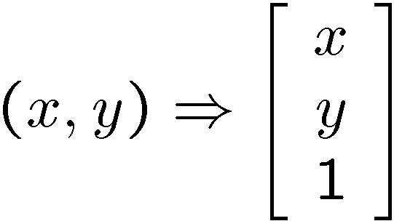
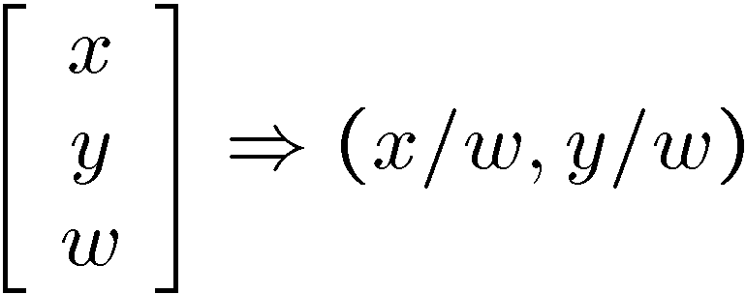
Homogeneous coordinates
(x, y, w)
w
Trick: add one more coordinate:
homogeneous plane
w = 1
(x/w, y/w, 1)
x
homogeneous image
coordinates
y
Converting from homogeneous coordinates

Slide 20
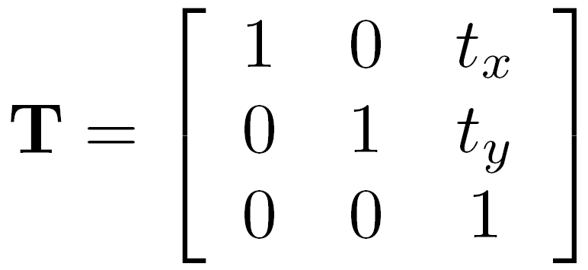
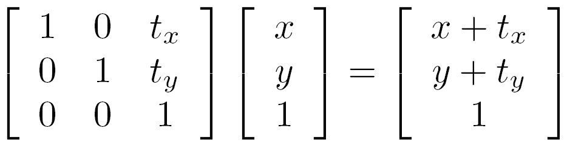
Translation
Solution: homogeneous coordinates to the rescue

Slide 21
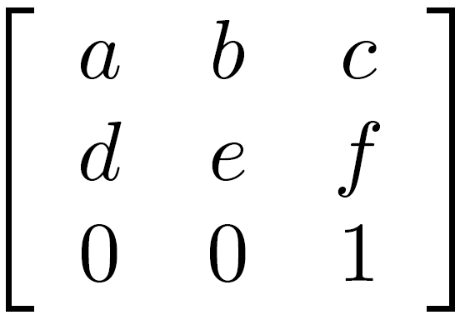
Affine transformations
any transformation represented by a 3x3 matrix with last row [ 0 0 1 ] we call an affine transformation

Slide 22
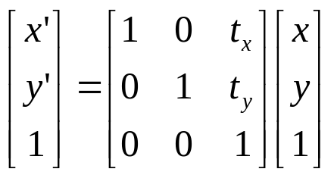
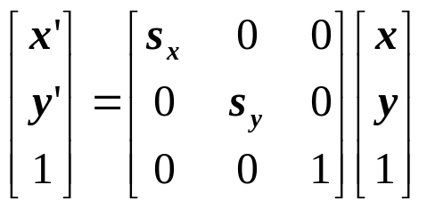
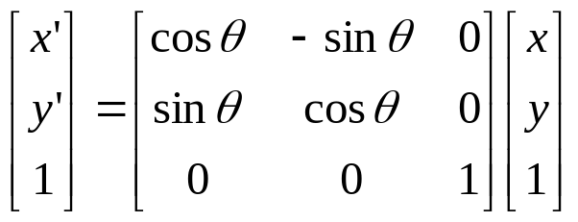
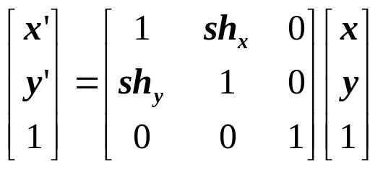
Basic affine transformations
Translate
Scale
2D in-plane rotation
Shear

Slide 23
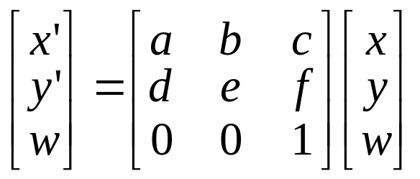
Affine transformations
Affine transformations are combinations of …
  Linear transformations, and
  Translations
Properties of affine transformations:
  Origin does not necessarily map to origin
  Lines map to lines
  Parallel lines remain parallel
  Ratios are preserved
  Closed under composition

Slide 24
Is this an affine transformation?

Slide 25
Where do we go from here?
what happens when we mess with this row?
affine transformation

Slide 26
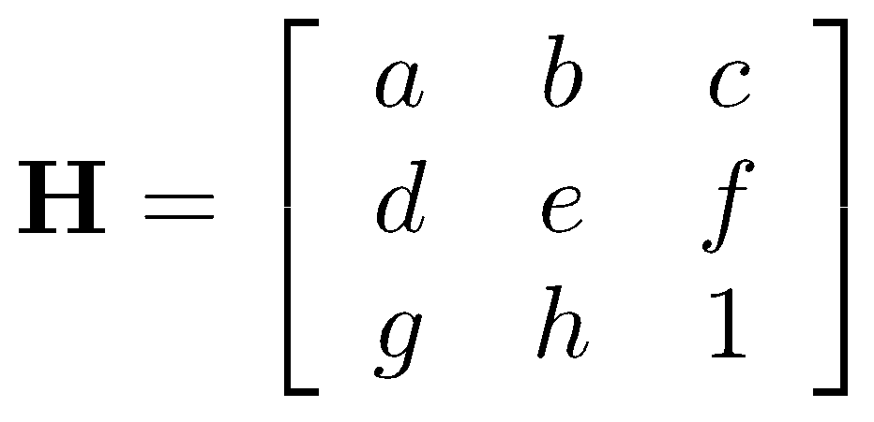




Projective Transformations aka Homographies aka Planar Perspective Maps
Called a homography
(or planar perspective map)

Slide 27
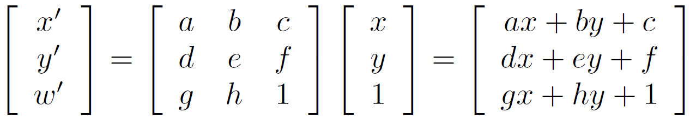
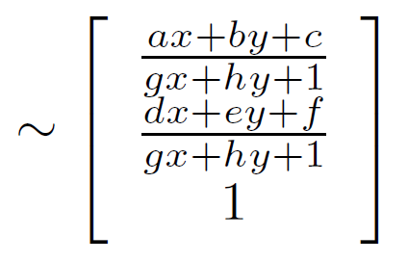
Homographies
What happens when the denominator is 0?

Slide 28
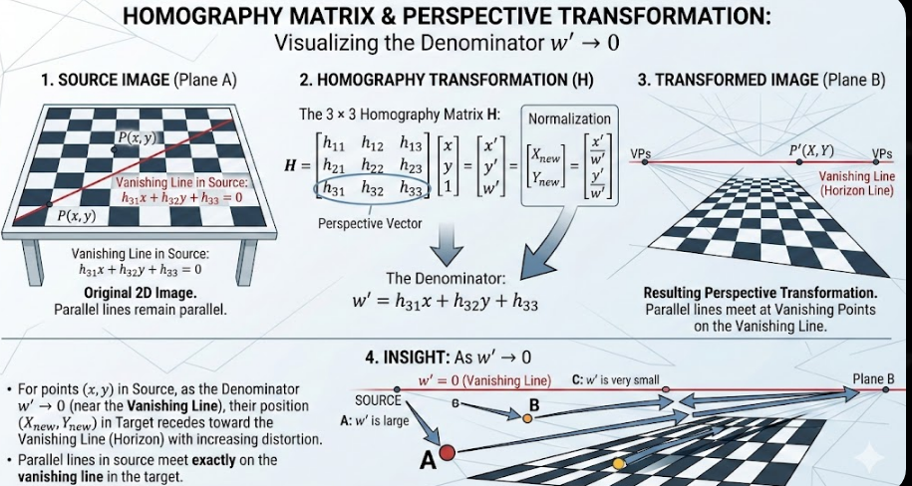
Homographies
What happens when the denominator is 0?

Slide 29
Points at infinity

Slide 30
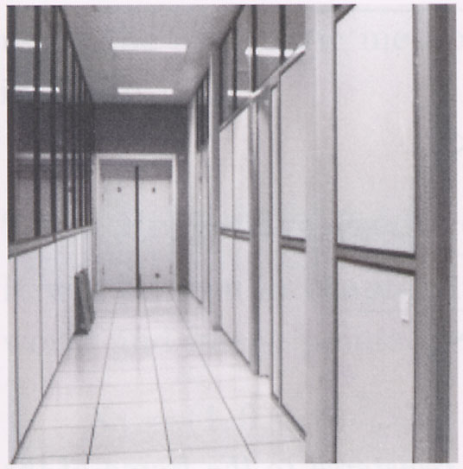
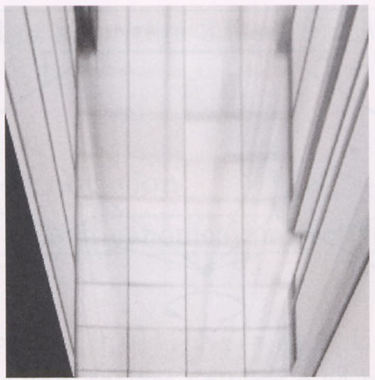


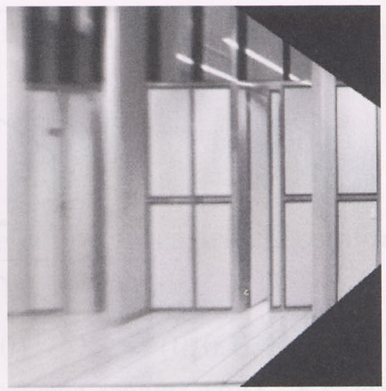
Image warping with homographies
image plane in front
image plane below
black area
where no pixel
maps to

Slide 31
Homographies

Slide 32
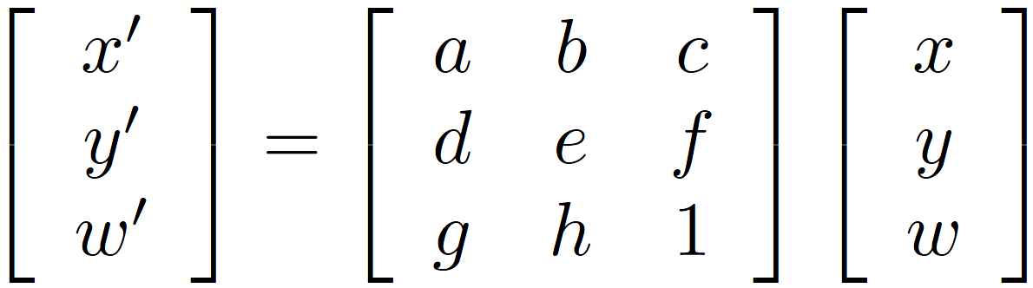
Homographies
Homographies …
  Affine transformations, and
  Projective warps
Properties of projective transformations:
  Origin does not necessarily map to origin
  Lines map to lines
  Parallel lines do not necessarily remain parallel
  Ratios are not preserved
  Closed under composition
Key fact: homographies are only defined up to a scale factor (e.g., H and 2H are equivalent homographies)

Slide 33
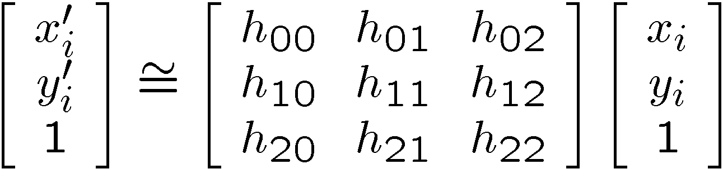
Alternate formulation for homographies
where the length of the vector [h₀₀ h₀₁ … h₂₂] is 1

Slide 34
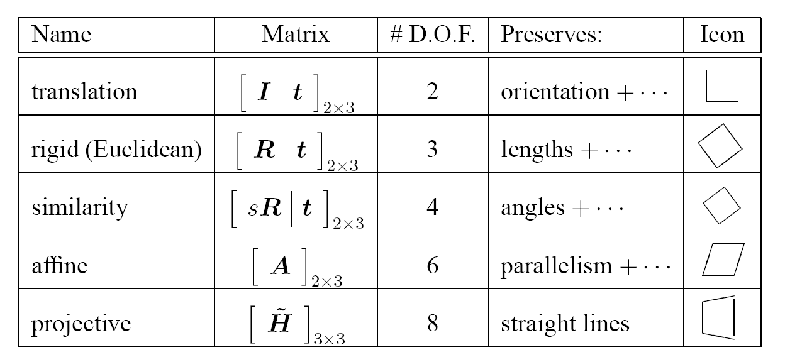
2D image transformations
These transformations are a nested set of groups
  Closed under composition and inverse is a member

Slide 35
Implementing image warping
Given a coordinate xform (x’,y’) = T(x,y) and a source image f(x,y), how do we compute a transformed image g(x’,y’) = f(T(x,y))?
y
T(x,y)
y’
x
x’
f(x,y)
g(x’,y’)

Slide 36
Forward Warping
Send each pixel (x,y) to its corresponding location (x’,y’) = T(x,y) in g(x’,y’)
What if pixel lands “between” two pixels?
y
T(x,y)
y’
x
x’
f(x,y)
g(x’,y’)

Slide 37
Forward Warping
Send each pixel (x,y) to its corresponding location (x’,y’) = T(x,y) in g(x’,y’)
What if pixel lands “between” two pixels?
Answer: add “contribution” to several pixels, normalize later (splatting)
Can still result in holes
y
T(x,y)
y’
x
x’
f(x,y)
g(x’,y’)

Slide 38
Inverse Warping
Get each pixel g(x’,y’) from its corresponding location (x,y) = T⁻¹(x,y) in f(x,y)
Requires taking the inverse of the transform
What if pixel comes from “between” two pixels?
y
T⁻¹(x,y)
y’
x
x’
f(x,y)
g(x’,y’)

Slide 39
Inverse Warping
Get each pixel g(x’,y’) from its corresponding location (x,y) = T⁻¹(x’,y’) in f(x,y)
What if pixel comes from “between” two pixels?
Answer: resample color value from interpolated (prefiltered) source image
y
T⁻¹(x,y)
y’
x
x’
f(x,y)
g(x’,y’)

Slide 40
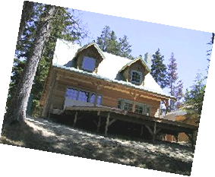
Interpolation
Possible interpolation filters:
  nearest neighbor
  bilinear
  bicubic
  sinc
Needed to prevent “jaggies”
and “texture crawl”
(with prefiltering)

Slide 41
Questions?

